Slide 1


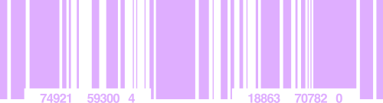




REPTON SCHOOL
NETWORK BLUEPRINT
Abdulrahman Alsikh
7858541
Muhammad Shaheer Kashif
7877146
Shah Mohammed Siam Ahbab
7825316
Marwan Mujeeb
7813223

Slide 2

CLIENT PROPOSAL
Respected,
We are writing to propose a comprehensive networking and communication infrastructure for your school, specifically designed to meet the operational requirements of your departments and branches. Our proposal includes the creation and designing of a network using Cisco Packet Tracer that will connect the following departments and branches: Library, Computer Lab 1-2, Cafeteria, and Staff Department. We have carefully considered the needs of each department and designed a network that will ensure efficient communication and data transfer between them.
To implement this network, we have used several devices on the packet tracer such as webcams to monitor all rooms, along with numerous devices that are required to maintain effective and productive communication and essential processes between devices and the rooms that are elucidated by our team member in the attached zoom meeting. This equipment is capable of providing the necessary bandwidth and connectivity to meet the demands of your school's departments and branches. In addition, we will provide comprehensive installation and maintenance services to ensure the smooth and uninterrupted operation of your network so the students and staff wouldn't face any disputes. We are confident that our proposal meets your requirements and will provide an effective networking and communication infrastructure for your school. If you have any questions or require further information, please do not hesitate to contact us.
Thank you for considering our proposal.
Sincerely,
Shaheer Kashif
Pioze Inc.

Slide 3

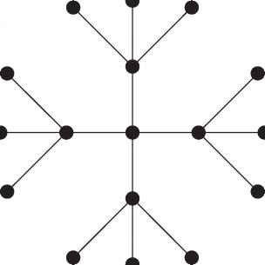

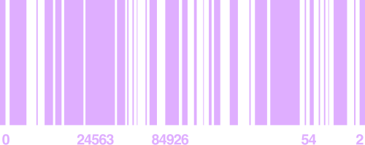
NETWORK
TOPOLOGY
The network topology chosen for the campus is the Extended Star Topology, which combines the properties of Star and Bus topologies. The topology consists of a Backbone Cable with multiple star topologies connected to it, each indicating a network segment or branch with a central point, usually a switch or hub. This topology was chosen due to its ability to support a large number of branches, allowing for easy extension of the network, easy modification, segregation of branches, minimized probability of a single point of failure, reduced overall network traffic, improved network performance, and easier management and troubleshooting of devices.

Slide 4
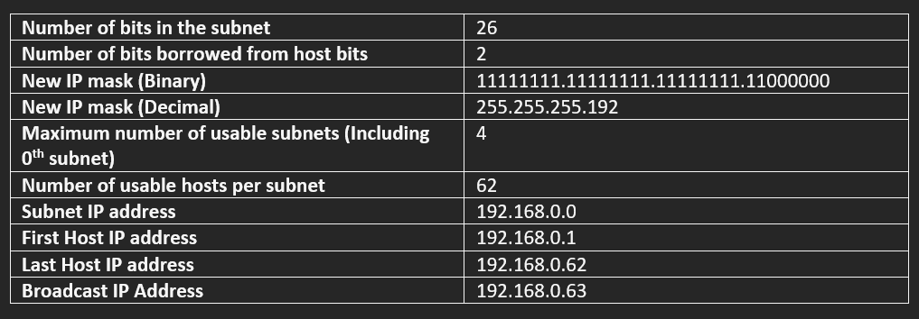
LIBRARY DEPARTMENT --> 35 HOSTS // BRANCH 1 SUBNET ADDRESS BLOCK

Slide 5

CAFETERIA --> 15 HOST // BRANCH 2
SUBNET ADDRESS BLOCK

Slide 6
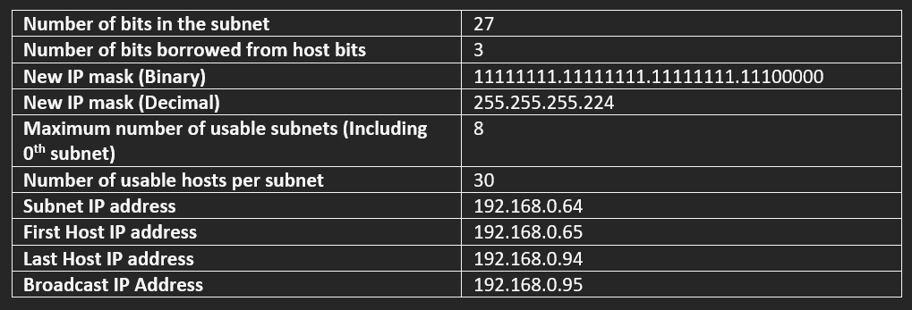
COMPUTER LAB 1 --> 25 HOST // BRANCH 3 SUBNET ADDRESS BLOCK

Slide 7

COMPUTER LAB 2 --> 25 HOST // BRANCH 4 SUBNET ADDRESS BLOCK

Slide 8

STAFF DEPARTMENT --> 20 HOSTS // BRANCH 5 SUBNET ADDRESS BLOCK

Slide 9


THANK
YOU!
Do you have any questions?
We hope you learned something new!

